Slide 1

Railroad Accident/Incident Risk Report
Tanner Hilt
Notes:
Introduction:
Capstone project predicts railroad accidents risk from FRA Form 54 data, using a two-stage machine learning pipeline.
One model to estimate a continuous risk score, the other classifies accidents into risk categories, using only information available at the moment an incident occurs.

Slide 2
Agenda
Capstone/ Data Setup
Preprocessing/ Feature Engineering
EDA
Methodology
Evaluation
Conclusion

Slide 3
Capstone/ Data Setup

Slide 4
Problem Setup
Research Question:
Is it possible to develop a risk model that helps professionals in the railroad industry determine the severity of an accident/ incident involving equipment?
Hypothesis:
Pre-incident features from the FRA Form 6180.54 data source provide enough information to establish risk scores and classifications for railroad accidents more effectively than a dummy model.

Slide 5
Dataset Source
Department of Transportation – Data.Transportation.Gov
Form 6180.54 from FRA
Active dataset
Dataset Overview
Database: PostgreSQL
224,700 records | 155 features
Range: 1975 – 2026

Slide 6
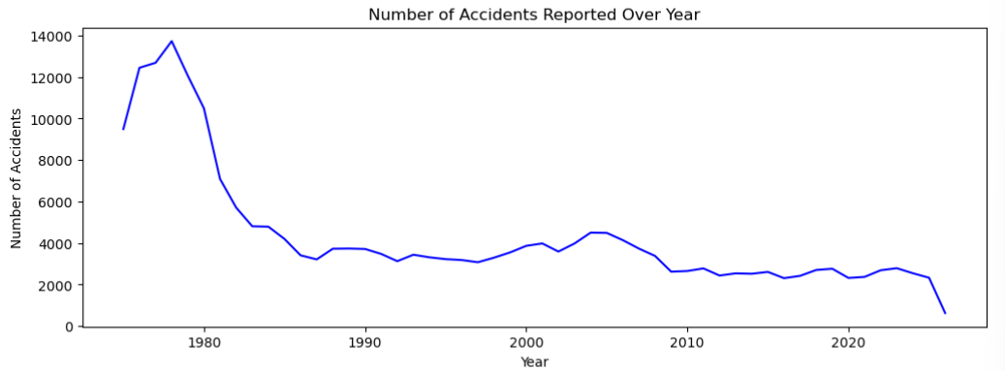

Slide 7
Preprocessing/ Feature Engineering

Slide 8
Data Preprocessing
Selected 26 fields (3 for Target Engineering) | 159,995 records
Data cleaning – value count method
Drop null values completely
Data Split – Chronological Order
Train Range (1975, 1997)
Validation Range (1998, 2011)
Test Range (2012, 2026)

Slide 9
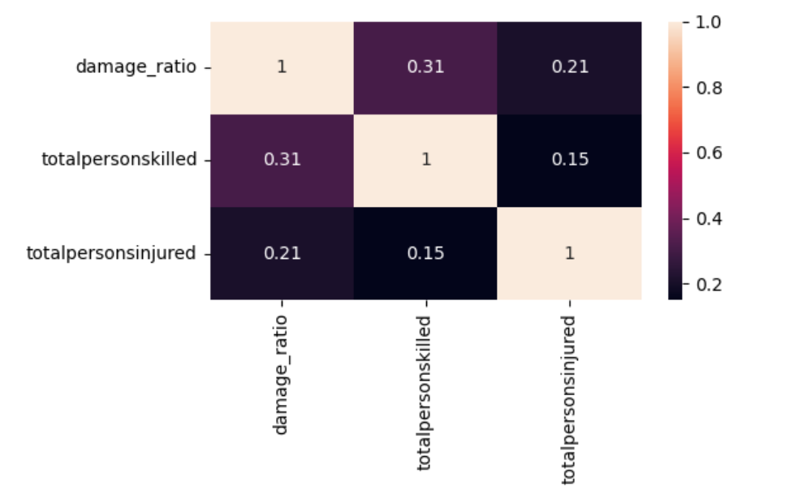
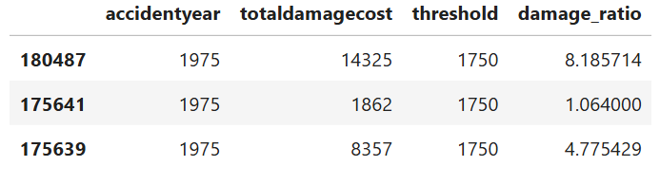
Feature Engineering
Risk Score
Three features: totaldamagecost, totalpersonskilled, and totalpersonsinjuried
damage_ratio: reported dollar damage / monetary threshold that year
PCA Method: Standardized - PC1 (loading values) - Scored
Notes:
Standardized using StandardScaler.
Ran PCA to find principal component and used its loadings as weights.
damage_ratio: 0.369
totalpersonskilled: 0.346
totalpersonsinjured: 0.285

Slide 10
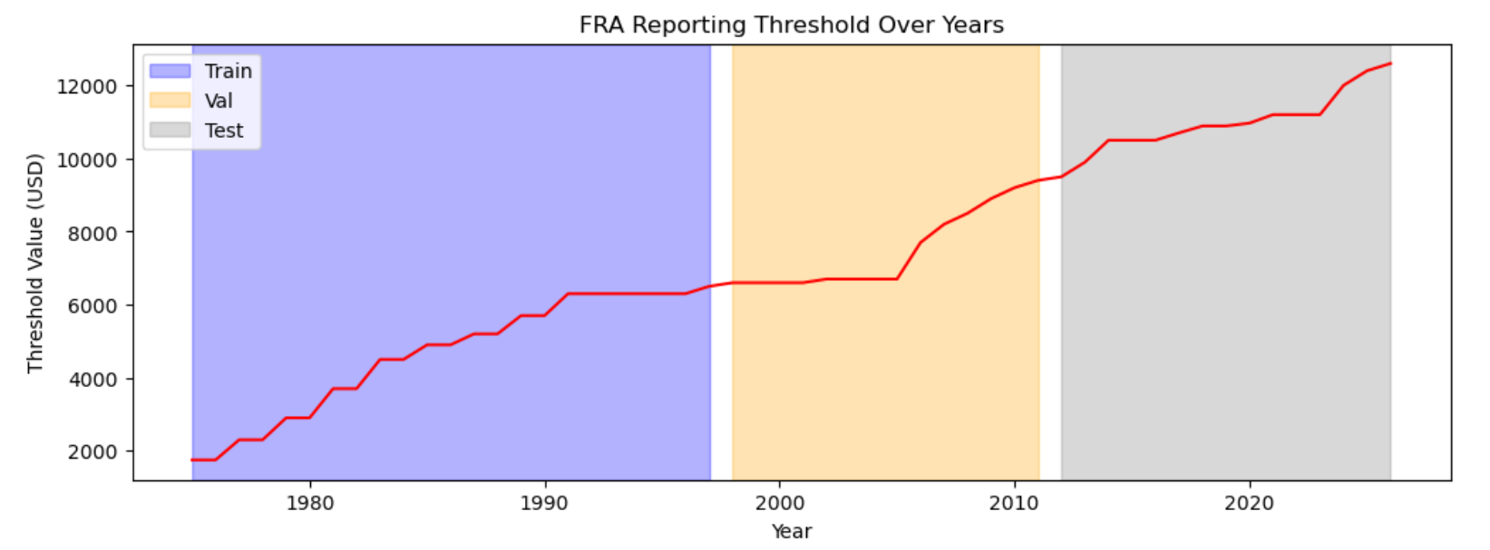
Feature Engineering – Threshold Value

Slide 11
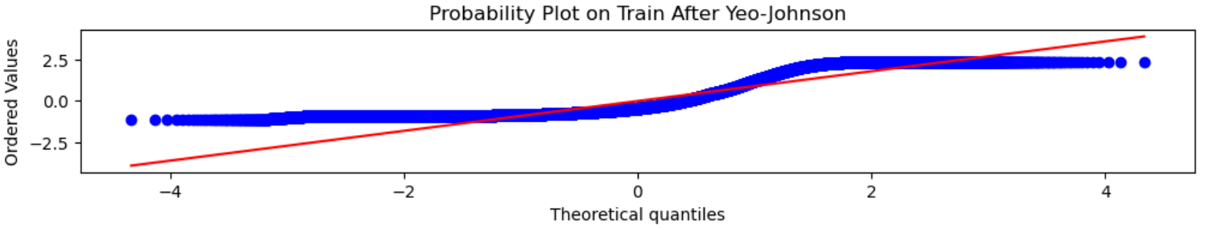
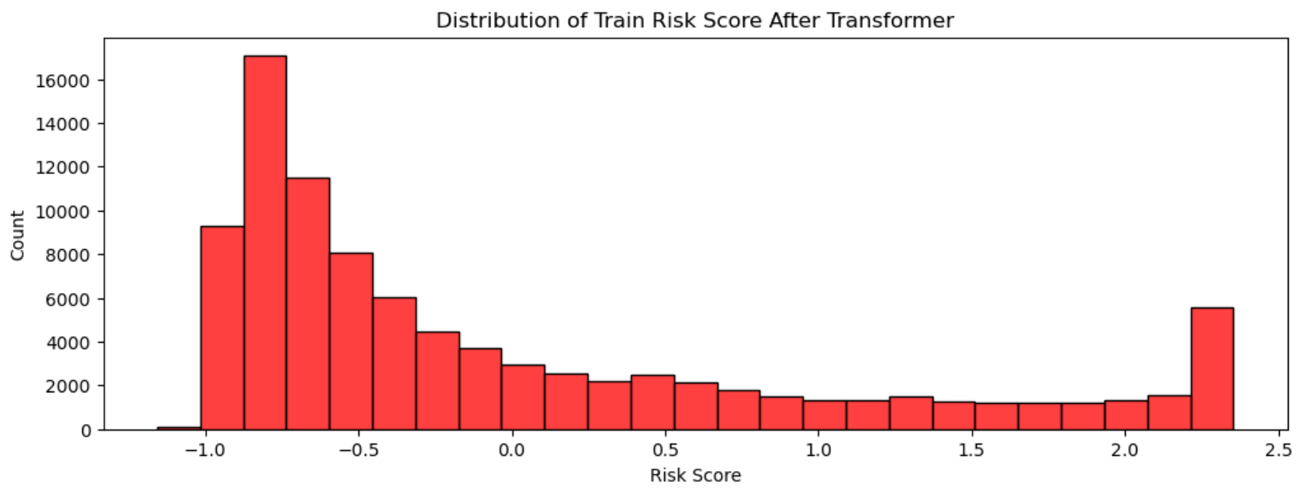
Feature Engineering – Yeo Johnson

Slide 12
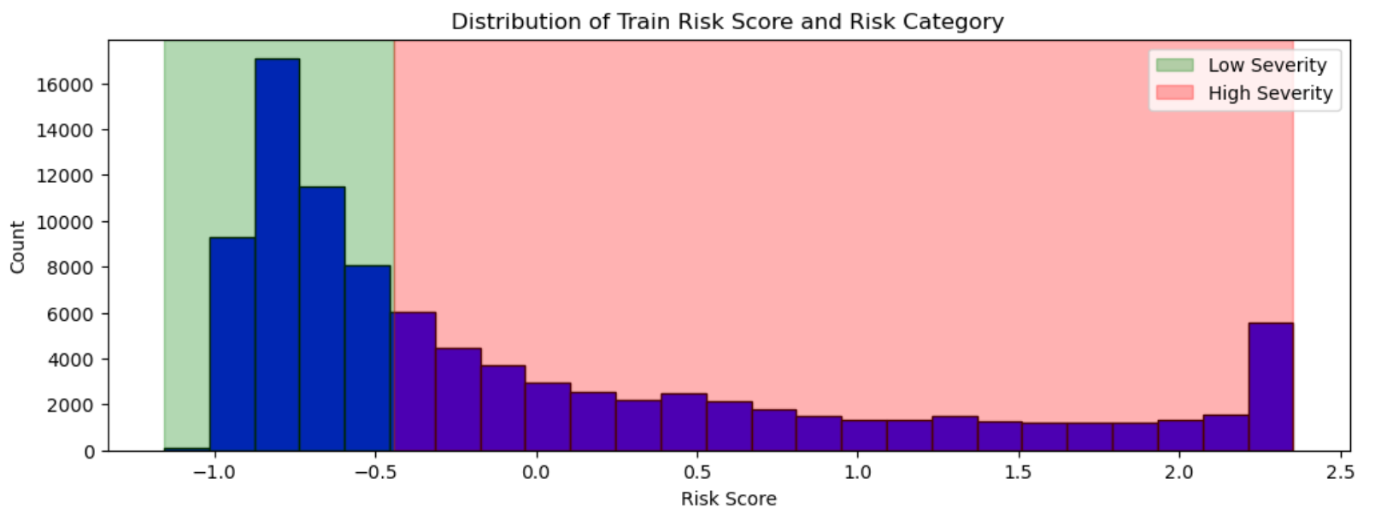
Feature Engineering – Risk Category

Slide 13
EDA

Slide 14
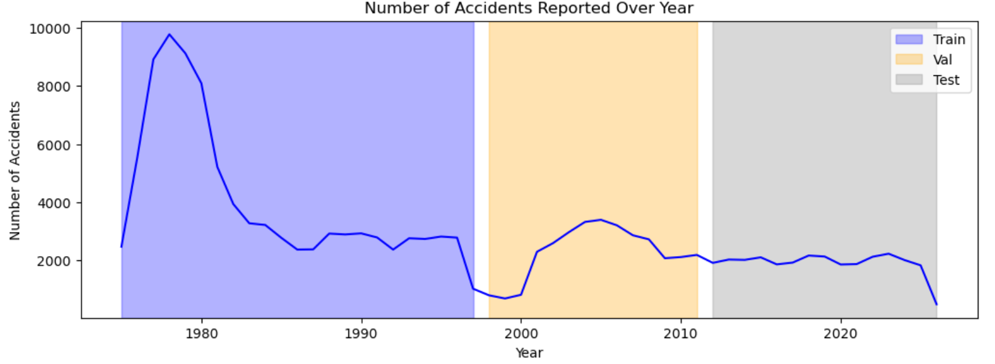
EDA – Reports Over Year

Slide 15
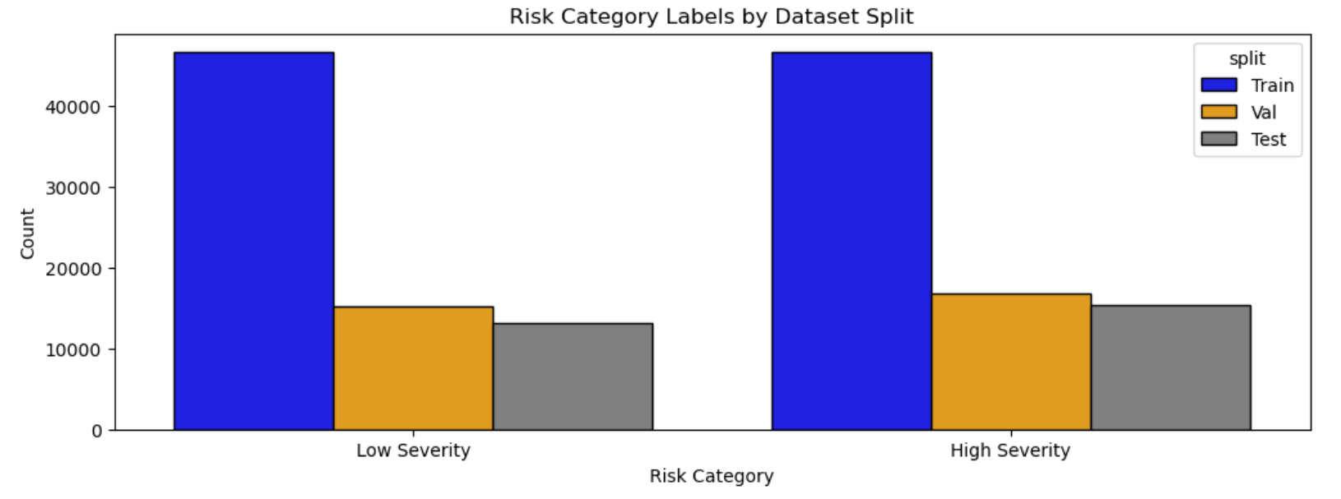
EDA – Risk Category Split

Slide 16
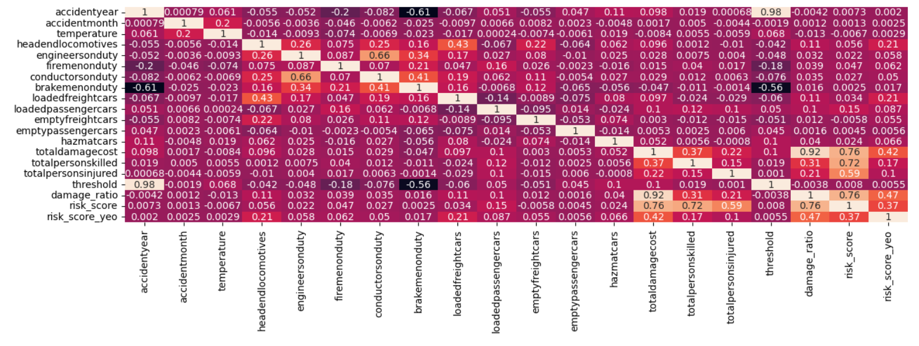
EDA – Correlation/ Cardinality/ Connection

Slide 17
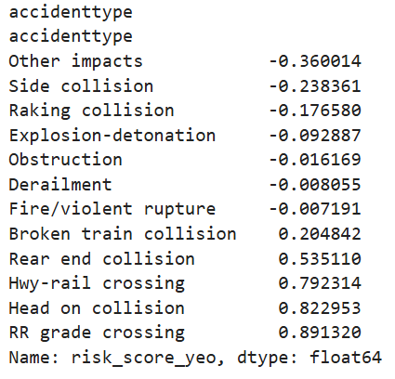
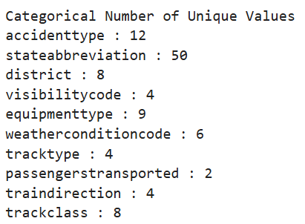
EDA – Correlation/ Cardinality/ Connection

Slide 18
Data Preparation
Dropped all features used of target engineering
Categorical Variables: OneHotEncoder
Numerical (excluding month): StandardScaler
Month: Sin and Cos
Final Feature Count: 121

Slide 19
Methodology

Slide 20
Model Explored
Linear Regression
KNN
XGBoost Regressor
XGBoost Classifier
Tuned via GridSearch
TimeSeriesSplit: 5-folds
Regression Scoring: “neg_root_mean_squared_error”
Classification Scoring: “f1_macro”

Slide 21
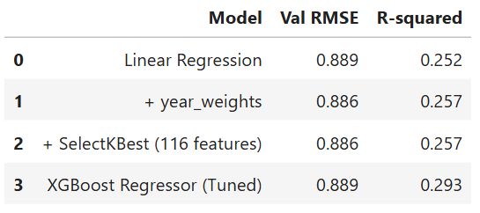
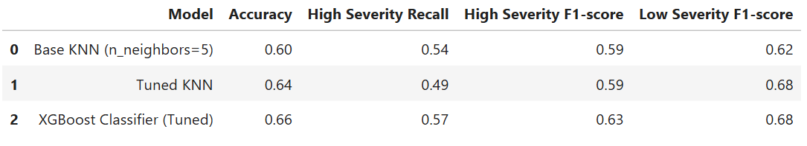
Model Results
Regression
XGBoost versions were selected as the final version for model evaluation and testing.
Classification

Slide 22
XGBoost Regressor and Classifier
Model’s In-Practice:
Begins with baseline prediction
Computer residuals/ gradients
Fit trees to the residuals
Scaled by set learning rate
Repeats
Model’s Parameters:
Random State: 42
Col Sample By Tree: 0.7
Sum Sample: 0.7
Learning Rate: 0.01
Max Depth: 7
N Estimators: 700
Model’s Objective: “Reg:SquaredError” or “Binary:Logistic”

Slide 23
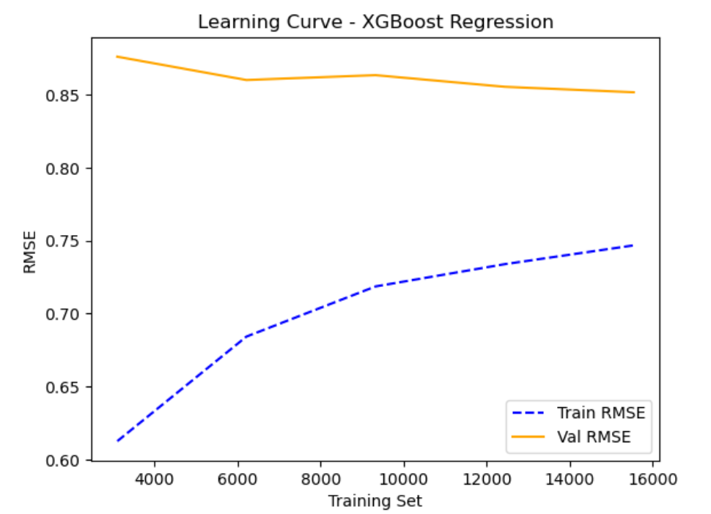
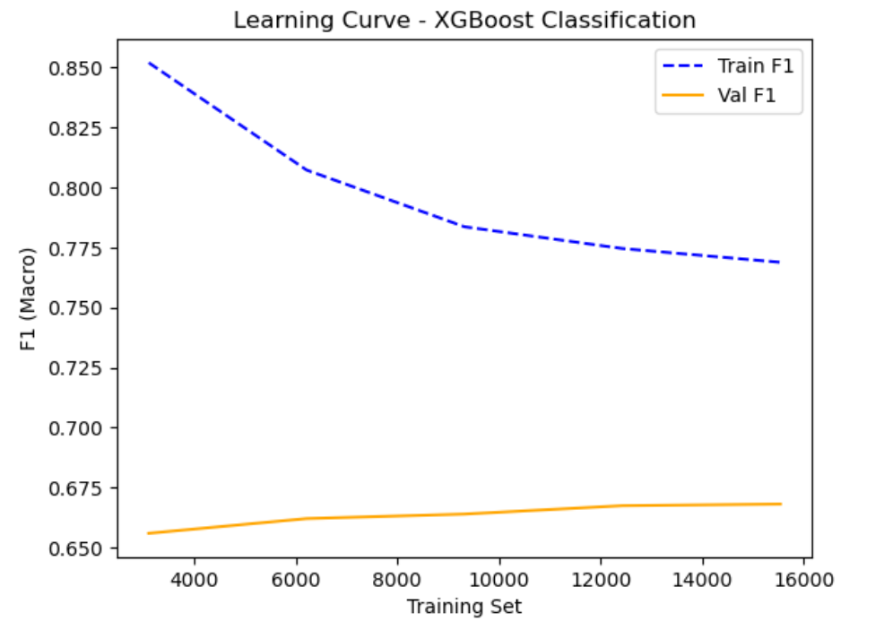
Model Learning Rate

Slide 24
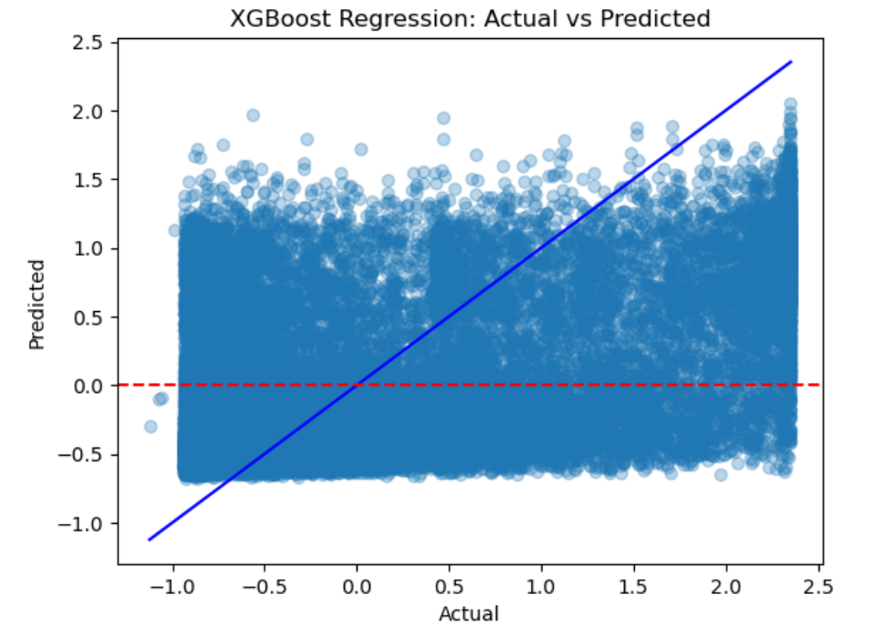
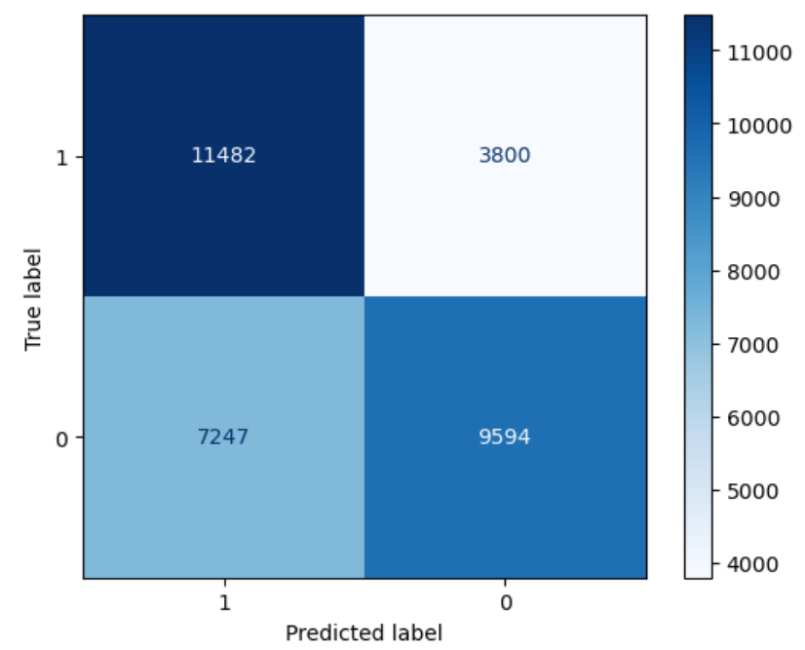
Model Performance

Slide 25
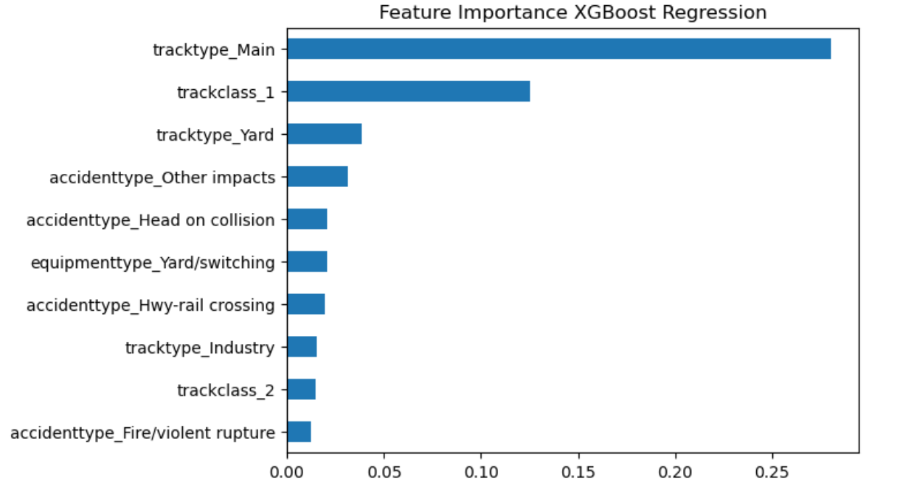
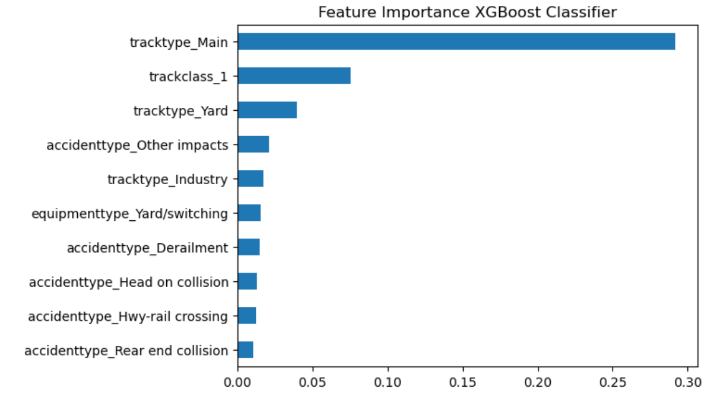
Model Feature Importance

Slide 26
Evaluation

Slide 27


Naïve Models
DummyRegressor (Strategy: Mean)
DummyClassifier (Strategy: Stratified)
Cross-Validation
Regression
Classification

Slide 28
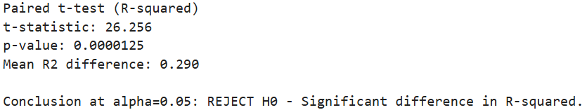
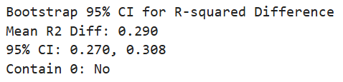
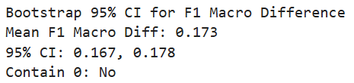
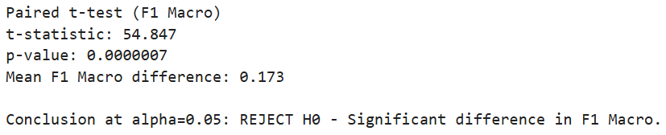
Paired t-test Bootstrap Resampling
Regression
Classification

Slide 29
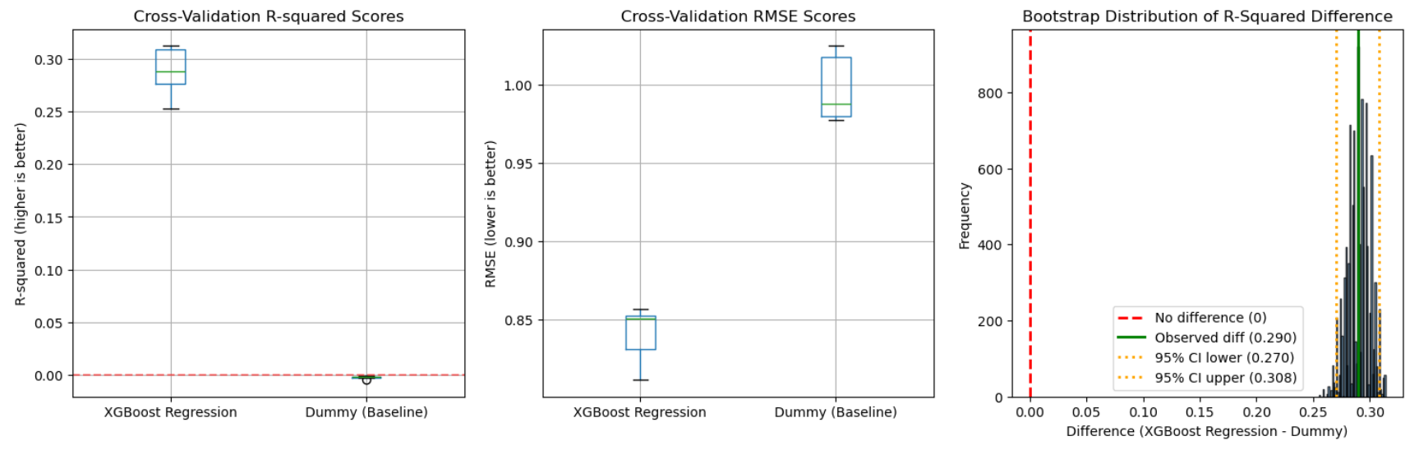
Regression Evaluation

Slide 30
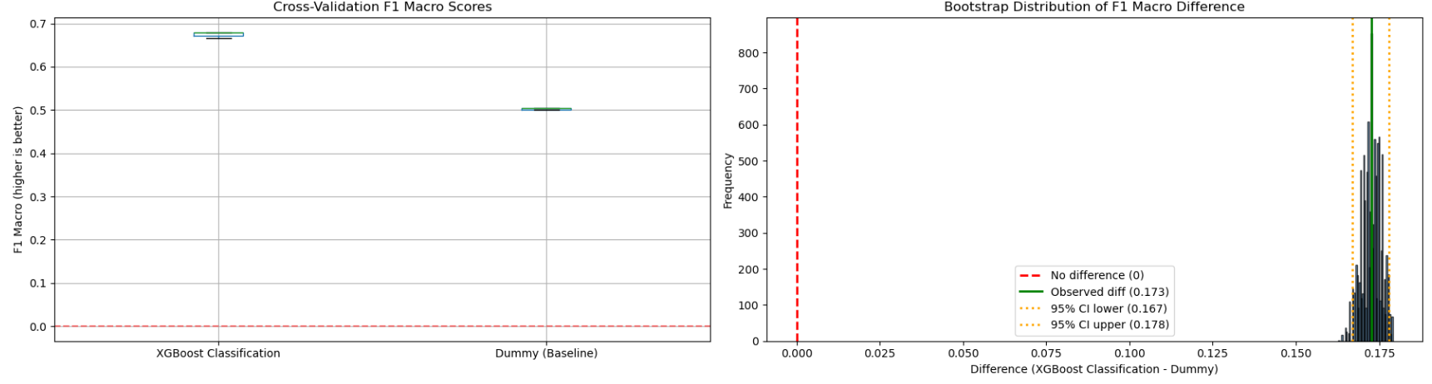
Classification Evaluation

Slide 31
Conclusion

Slide 32
Interpretation
Both models beat their baseline by a statistical margin.
Pre-incident conditions do carry a real predictive signal.
Society Impact
A decision-support tool for railroad companies’ internal risk management team. NOT a final decision-maker.
R-squared indicate signal is present, but there is still unexplained variance.
Classification captured more then 50% of High Severity cases, but missed 43%.

Slide 33
Biases
High Severity Bias: Considered rare and unpredictable.
Time-based Bias: Patterns have shifted over time.
Limitations
Not enough features with predictive patterns to capture a strong signal.
Addressing drift in severity. Need additional evidence to strength what is threshold.
Risk score is expressed in standard formatting. Hard to interpret.

Slide 34
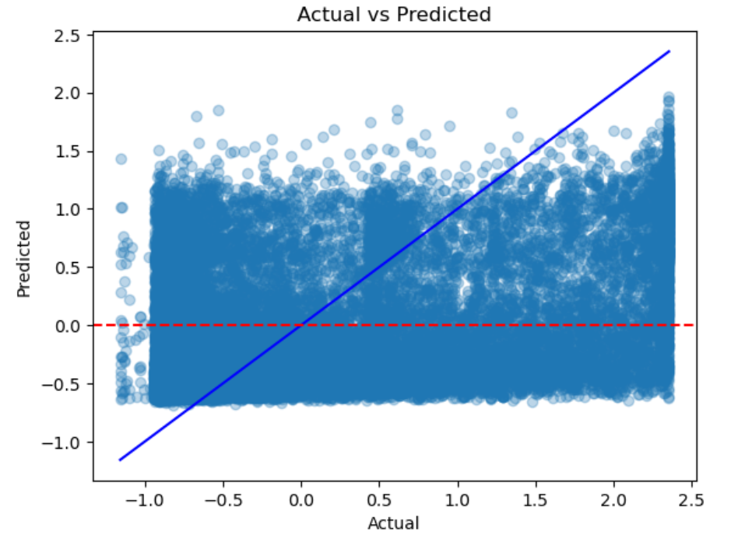
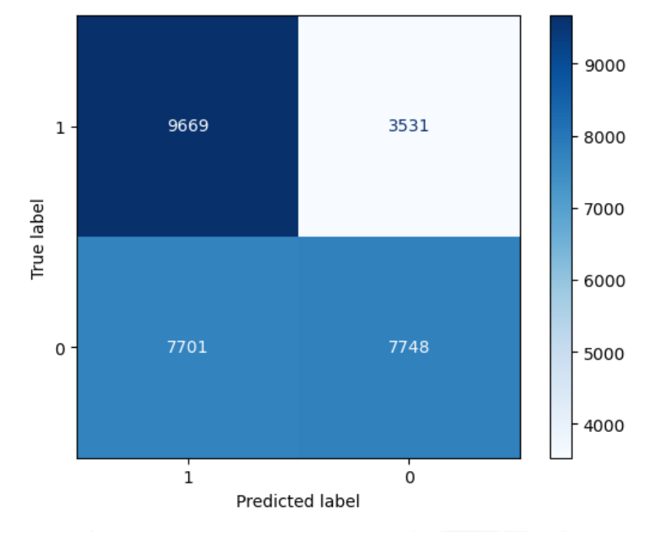
Test Set Results

Slide 35
Conclusion
Pre-incident conditions carry real, statistical signal about accident risk and severity.
Two-stage pipeline outperformed naïve baseline models with confirmed significance.
Tackle severity drift and class imbalance before any real deployment conversations.

Slide 36
Thank You!

